Slide 1

ANNUAL GENERAL MEETING
WEDNESDAY 13 May 2026
Marks Park
6:30 pm

Slide 2
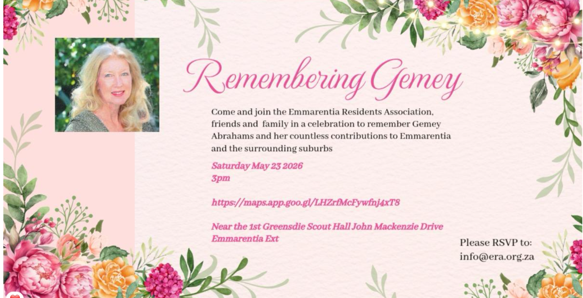

Slide 3
Agenda
Welcome
Adoption and Matters arising of last AGM
Finance
Compliance
Infrastructure
Environment
Communication
Safety and Security
Events
Ward Councillor & Committee
Chairmans Report
Q&A session
Volunteers for ERA
Close

Slide 4
FINANCE
Financial Statement
Treasurers Report
Highlights :
Membership Drive
NPO registration process commenced
New Software implemented

Slide 5
PLANNING AND HERITAGE
Building plans continued
We liaise with estate agents on the by-laws and Heritage applications
We have engaged with Estate Agents selling in Emmarentia to ensure they are aware of heritage laws and the Louw Geldenhuys Trust (information on website) and densification laws.
We give residents advice on building plans and materials that can be used.
If your house is over 60 years’ old and you do renovations, you have to apply to the Provincial authorities for permission to change your building – applies to every property in South Africa
Try to retain original features of your home – it brings continuity of history for future generations and can add value
Please advise your neighbours when you intend building
Please do not build before plans are approved

Slide 6
PLANNING AND HERITAGE
To maintain our suburb of Emmarentia as an organized, compliant area where we know the property regulations and abide by them for the benefit of all.
Please check our website before carrying out any alterations, www.era.gov.za to see if its permitted or if you need apply for additional rights
Please have your title deeds available before renovating
Ensure your building plans are as per your property
Not sure email us on info@era.gov.za and we will assign someone to assist
Please submit building plans to ERA before submitting to the City or to PHRAG
Building Plans

Slide 7
COMPLIANCE
Tragic passing of Gemey Abrahams – left a void
Compliance Committee appointed – Bienfeit, Mohamed, Rudesh, Jenny & Kim
Densification correspondence sent out setting ERA position on development
Handled over 4 Applications for alterations – LG Trust and Heritage
We need more hands on deck – Town Planner or Architect

Slide 8
SAFETY&SECURITY
ERA now sits on the Parkview SAPS CPF
Crime statistics for Emmarentia continue to trend significantly lower than both national and Gauteng provincial averages.
Although recorded crime levels remain relatively low, statistics alone do not provide a complete reflection of the area’s safety challenges. Underreporting remains a concern, and residents are strongly encouraged to report all crime-related incidents to ensure accurate data and appropriate response.
A successful appeal has been made for enhanced security measures at the Botanical Gardens, strengthening safety within this important community asset.
The relevant authorities have been formally alerted to abandoned and derelict properties that have been unlawfully occupied and are contributing to criminal activity. Residents are encouraged to report any such properties to assist in coordinated action.
Residents are urged to attend public meetings convened by the Community Policing Forum (CPF) to promote accountability, remain informed on safety matters, and foster active community engagement.
ERA has received a letter of allegations against Parkview SAPS and we have responded appropriately to all parties concerned.

Slide 9
ENVIRONMENT
Cleared up the back of the Scouts Hall , Opp JM & Limpopo triangle, southern portion of spruit facing JM from 5th Ave till Limpopo, both sides of spruit from Scouts Hall to Dam Wall
Planted 3 x Trees and installed 1 x Bench for the Gemey Memorial Garden
Numerous clean ups of dumping within the spruit conducted.
Coordinating with JBG and external party to repair dam run off area.
Cleared up the Dam Wall along Olifants and Louw Geldenhuys
Resource taken on to clean up the environment
Inside JBG - April 2025 with an established group of mostly dog-walkers that have been weeding and picking litter around the new dam
inside JBG on a regular basis. - Aug 2025 organised a community clean up inside Adopt a park area; and helped coordinate a group of about 90 Roosevelt learners who helped clean/weed inside JBG with the established weeding group.

Slide 10
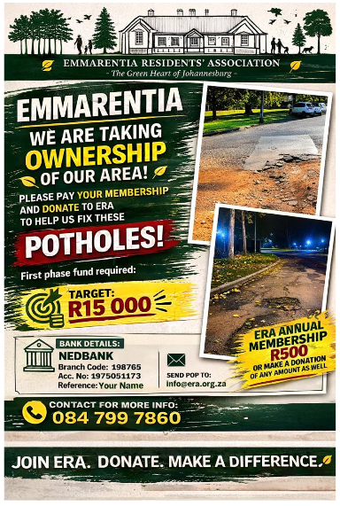
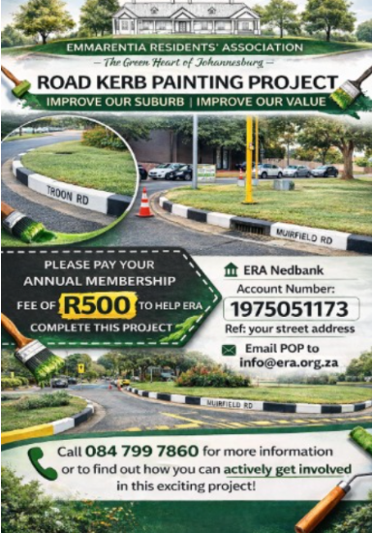
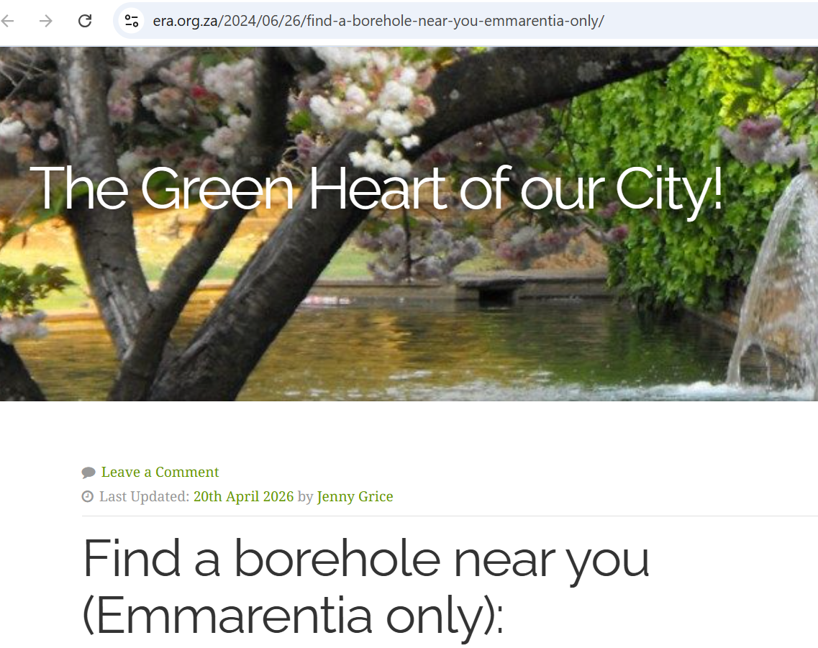
INFRASTRUCTURE

Slide 11
INFRASTRUCTURE
Road Kerb Names painted on 40 of 49 roads in Emmarentia
15 minor Potholes repaired – 4 major potholes repaired
Arranged COJ water tankers during water shortage.
Established a direct line to JW Seniors for serious issues.
Compiled and circulated a geo location map of all boreholes in Emmarentia.
Report , Report , Report
Taking Ownership.

Slide 12

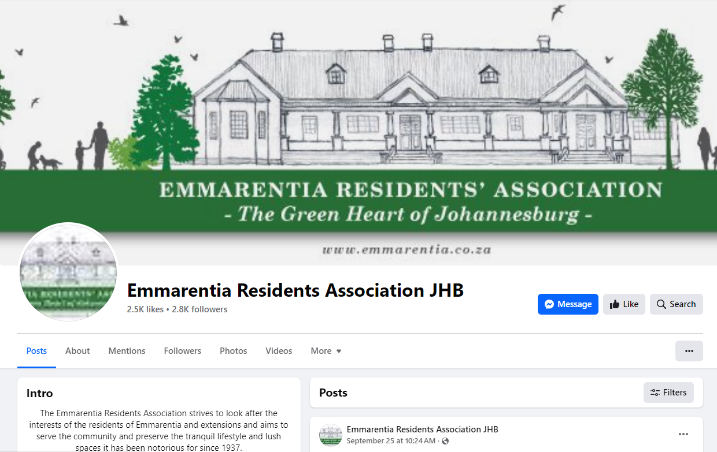
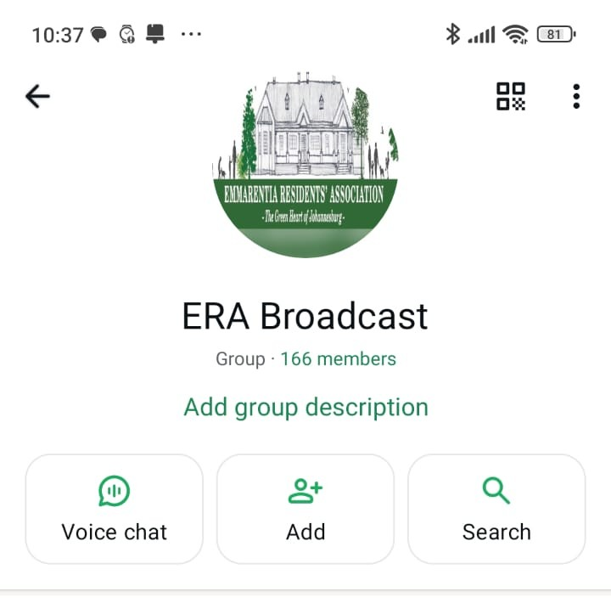
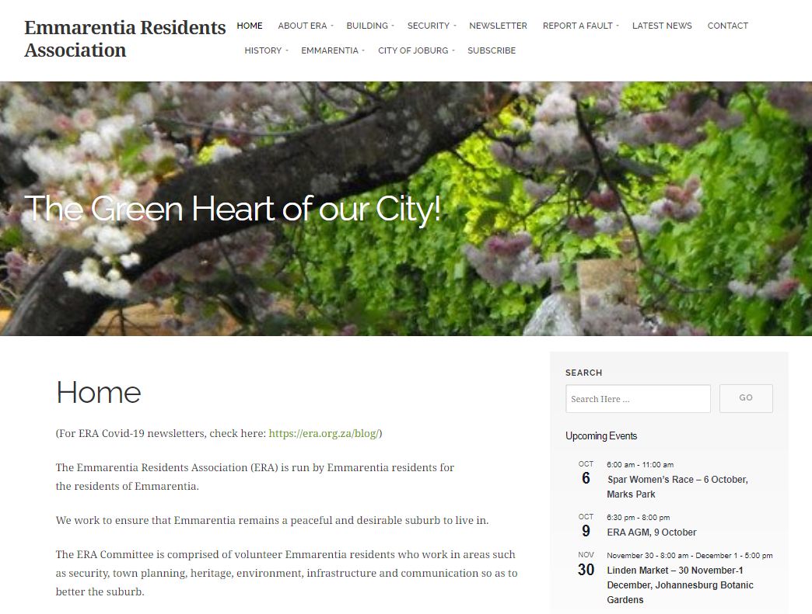
COMMUNICATION
2835 followers on FACEBOOK
490
E-MAIL SUB-SCRIBERS
166 Community Members on our WHATSAPP GROUP
11200 views the past year on WEBSITE
Join our Whats App Broadcast Group to receive info!
https://chat.whatsapp.com/I1Ix7SZXk2DBlSxKrwqXY3
To join our mailer email:
info@era.org.za
WE NEED HELP WITH OUR NEWSLETTER – PLEASE JOIN AND HELP ME

Slide 13

Events 2025 - 2026
Future events at Marks Park
VanFokKingTastic – 6 June
Total Sports Womens Race – 16 August
Parklive – 22 August
Tribute to Women – 29 August
Runzone – 6 September
Spar Ladies Race – 4 October
Boxer Run – 8 November
Future events at Botanical Gardens
Linden Market – 30 May, 27 Sept and 28 November
Liefde by die Dam – 1 August
We will continue to work with Marks Park and the Botanical Gardens to ensure residents’ concerns are acknowledged and that organizers keep to their word.
We would like to work closer with Dabulamanzi Canoe Club.
Several large events have attracted between 2,000 and 13,000 extra visitors to our suburb.
These events have been shared via the ERA Broadcast channel and WhatsApp groups.
Complaints to ERA have reduced – Noise, litter and traffic / parking.
I met with event organizers and attended ESSPC meetings at Parkview Police Station to ensure residents concerns are addressed.
​​

Slide 14
WARD COMMITTEE
ERA now sits on the Ward 88 Committee
ERA represents Infrastructure
Sits Monthly
Raise City Service Issues to the Councillor.
Raised over 15 issues to the Councillor for her escalation.

Slide 15
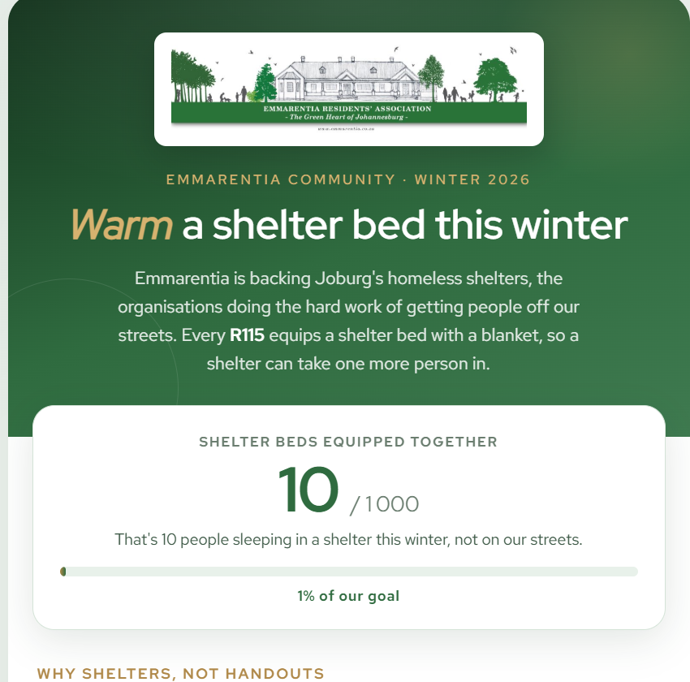

SOCIAL INITIATIVES

Slide 16
CHAIRMAN REPORT
Purpose of ERA :
Improve and enhance the stature of the suburb.
Representative of Residents and Businesses of suburb.
Approve any building change for Louw Geldenhuys Trust.
Provide Heritage Letters for alterations
Operations
Exco – portfolio driven who work voluntarily
Monthly Exco meetings , Ward Committee, CPF, COJ, Other RA’s
Projects/Interventions :
Adopt a Park
Road Names
Gemey Memorial
Dam Clean up
36 John Mackenzie
Borehole Listing
Membership Drive
New Projects
Membership Drive
Pothole repair
Environmental Team

Slide 17
Q & A

Slide 18
VOLUNTEERS

